Slide 1



Optimizing Systematic Review Processes with AI
Combining music and reminiscence therapy interventions
for wellbeing of elderly populations

Slide 2


Table Of Contents
01
About the
Case Study
05
Results
02
Objectives
06
Conclusion
03
Architecture
07
Our Team
04
Process Diagram

Slide 3


The Case study
Our case study is based on the research paper "Combining Music and Reminiscence Therapy Interventions for Well-being in Elderly Populations: A Systematic Review." This study explores how integrating music therapy with reminiscence therapy can improve emotional, cognitive, and social well-being in older adults.
By applying our AI-driven systematic review process, we efficiently analyzed a vast body of research, identifying key findings with greater speed and accuracy. This approach not only streamlined the literature review but also demonstrated how AI can support evidence-based interventions in healthcare and psychology.
Our case study highlights the power of AI in accelerating research while preserving human expertise—ensuring that meaningful insights contribute to enhancing the quality of life for elderly populations.
reallygreatsite.com

Slide 4

Objectives
Accelerate Research Analysis – Use AI-driven systematic reviews to speed up the selection and evaluation of scientific literature.
Enhance Decision-Making – Improve accuracy and objectivity in identifying relevant studies for evidence-based healthcare interventions.
Support Human Expertise – Assist researchers by automating tedious screening tasks, allowing them to focus on deeper analysis and critical thinking.
Ensure Ethical & Transparent Research – Maintain human oversight in decision-making to uphold quality, fairness, and reproducibility.
Demonstrate Real-World Impact – Apply AI to a case study on music and reminiscence therapy for elderly well-being, showcasing its effectiveness in healthcare research.

Slide 5
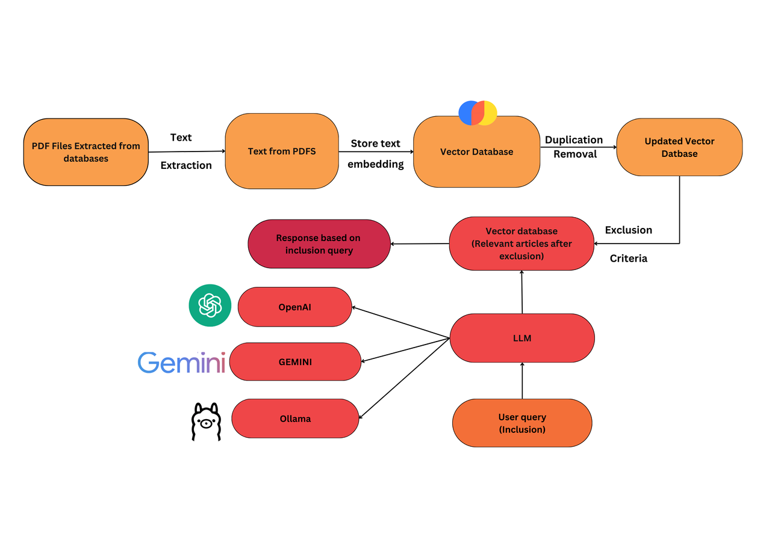
Architecture

Slide 6
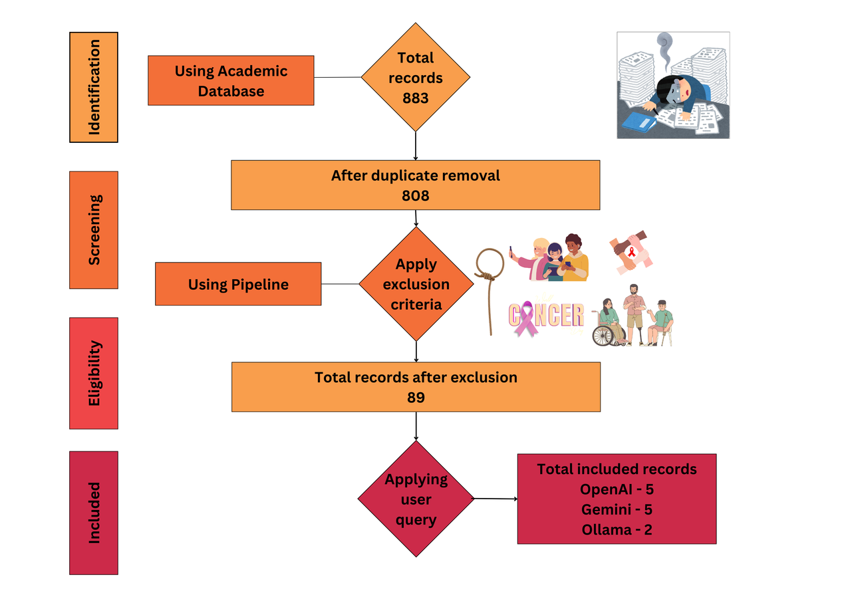

Process Diagram
reallygreatsite.com

Slide 7
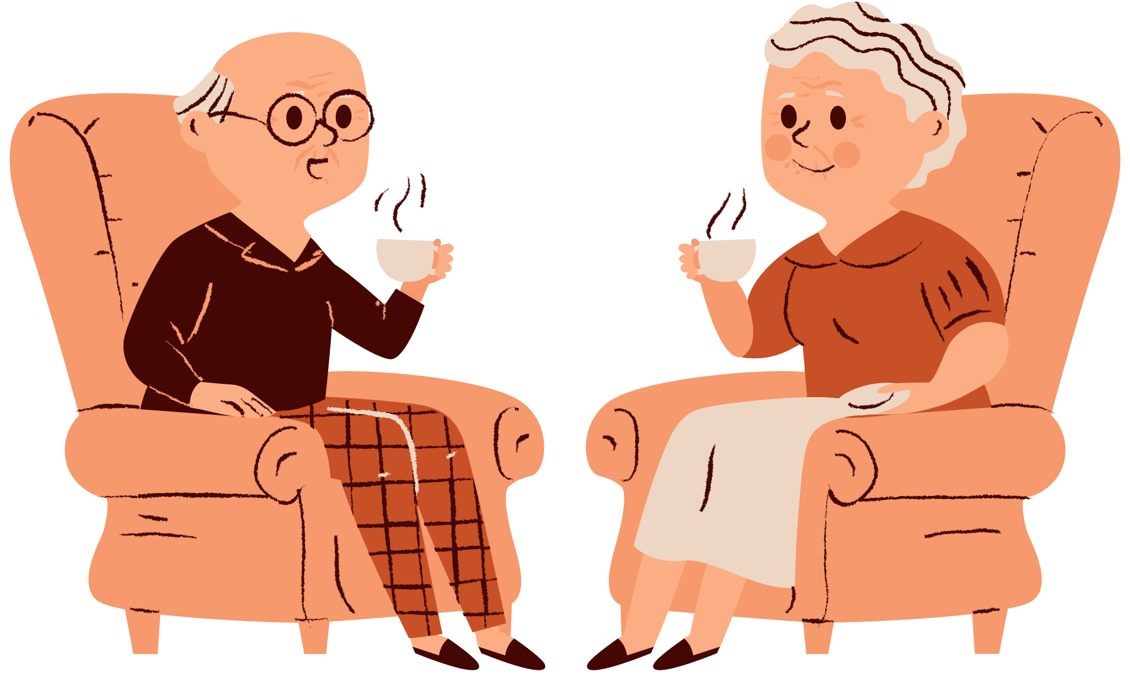
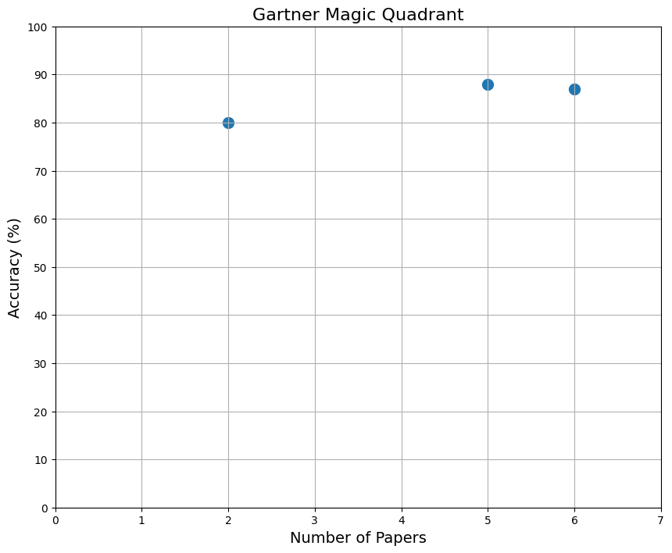






Results
The result after applying the LLMs to select the relevant papers shows how accurate the articles that result from the process are vs the research question. The research question was “ Combining music and reminiscence therapy interventions for wellbeing in elderly populations?”
The accuracy measure indicates papers selected using the keywords of the question. -music - reminiscence- elderly - intervention- wellbeing
5 papers
2 papers
6 papers

Slide 8





Impacts
Faster processing of large datasets compared to manual reviews.
Helps healthcare professionals understand the evidence-backed benefits of music therapy.
AI could help identify which types of music therapy work best for specific conditions.
Conclusions
AI can speed up research by streamlining paper selection and enhancing systematic reviews with LLMs. This approach can be applied to any scientific field by defining search parameters and exclusion criteria. In the end, the research question remains human-driven, with AI assisting in the process and analysis.

Slide 9
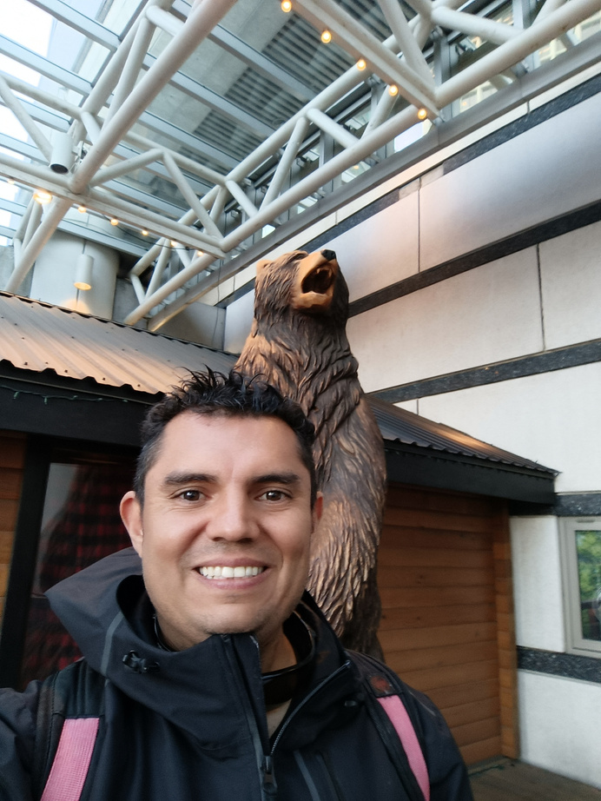






Our Team
Mario Palomino
Komalpreet
Mariopalominov@hotmail.com
komalpbrar123@gmail.com
+1 604 779 9052
+1 778 863 2634
Rachel Mendonsa
Sandaru Welikala
rachelgwen997@gmail.com
sandaruw@gmail.com
+1 236 334 5870
+1 672 866 0057

Slide 10
Thank You
Acknowledgement
We would like to express our gratitude to Monica Nguyen for her guidance and invaluable support, as well as to Michael Lo and for his insightful contributions to the overall development of the project.

